Slide 1
FILES AND EXCEPTIONS

Slide 2
FILES
To open a ﬁle, you specify its name and indicate whether you want to read or write
>>> f = open("test.txt","w")
>>> print f
<open file ’test.txt’, mode ’w’ at fe820>
    First argument: Name of the ﬁle
    Second argument: mode (“r” for Read/”w” for Write)
If there is no ﬁle named test.txt, it will be created. If there already is one, it will be replaced by the ﬁle we are writing.
If we try to open a ﬁle that doesn’t exist, we get an error:
>>> f = open("test.cat","r")
IOError: [Errno 2] No such file or directory: ’test.cat’

Slide 3
WRITING DATA
To put data in the ﬁle we invoke the write method on the ﬁle object with w
>>> f = open("test.txt","w")
>>> f.write("Now is the time")
>>> f.write("to close the file")
Closing the ﬁle tells the system that we are done writing and makes the ﬁle available for reading
>>> f.close()

Slide 4
READING DATA
To read the data from the ﬁle we invoke the read method on the ﬁle object with r
>>> f = open("test.txt",“r")
>>> text = f.read()
>>> print text
Now is the timeto close the file
Read can also take an argument that indicates how many characters to read
>>> f = open("test.txt","r")
>>> print f.read(5)
Now i

Slide 5
READING CONTINUED
If not enough characters are left in the ﬁle, read returns the remaining characters. When we get to the end of the ﬁle, read returns the empty string:
>>> print f.read(1000006)
s the timeto close the file
>>> print f.read()
>>>

Slide 6
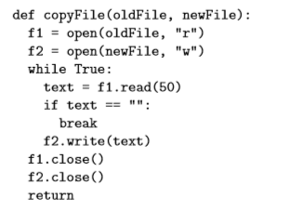
EXAMPLE 1
The following function copies a ﬁle, reading and writing up to ﬁfty characters at a time. The ﬁrst argument is the name of the original ﬁle; the second is the name of the new ﬁle

Slide 7
TEXT FILES
A text ﬁle with three lines of text separated by newlines
>>> f = open("test.dat","w")
>>> f.write("line one\nline two\nline three\n")
>>> f.close()
The readline method reads all the characters up to and including the next newline character:
>>> f = open("test.dat","r")
>>> print f.readline()
line one
>>>
readlines returns all of the remaining lines as a list of strings:
>>> print f.readlines()
[’line two\012’, ’line three\012’]

Slide 8
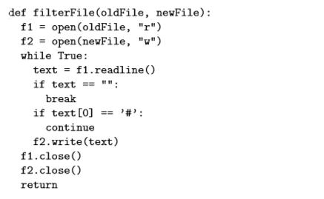
EXAMPLE 2
The following is an example of a line-processing program. filterFile makes a copy of oldFile, omitting any lines that begin with #:

Slide 9
WRITING VARIABLES
To write data types other than string, do
>>> x = 52
>>> f.write (str(x))
or use the Format Operator
>>> cars = 52
>>> "%d" % cars
’52’
Another example:
>>> cars = 52
>>> "In July we sold %d cars.“ % cars
’In July we sold 52 cars.’

Slide 10
WRITING VARIABLES – FORMAT OPERATOR
%f for floats, %s for strings
>>> "In %d days we made %f million %s." % (34,6.1,’dollars’)
’In 34 days we made 6.100000 million dollars.’
>>> "%d %d %d" % (1,2)
TypeError: not enough arguments for format string
>>> "%d" % ’dollars’
TypeError: illegal argument type for built-in operation
For more control over the format of numbers, we can specify the number of digits as part of the format sequence:
>>> "%6d" % 62
’ 62’
>>> "%12f" % 6.1
’ 6.100000’
The number after the percent sign is the minimum number of spaces the number will take up.

Slide 11
WRITING VARIABLES – FORMAT OPERATOR
If the value provided takes fewer digits, leading spaces are added. If the number of spaces is negative, trailing spaces are added:
>>> "%-6d" % 62
’62 ’
For ﬂoating-point numbers, we can also specify the number of digits after the decimal point:
>>> "%12.2f" % 6.1
’ 6.10’

Slide 12
DIRECTORIES
If you want to open a ﬁle somewhere else, you have to specify the path to the ﬁle, which is the name of the directory (or folder) where the ﬁle is located:
>>> f = open("/usr/share/dict/words","r")
>>> print f.readline()
Aarhus
This example opens a ﬁle named words that resides in a directory named dict, which resides in share, which resides in usr, which resides in the top-level directory of the system, called /.
You cannot use / as part of a ﬁlename; it is reserved as a delimiter between directory and ﬁlenames.

Slide 13
PICKLING
Things are written as strings in files. To get the original data structures (like lists, dictionaries) back, use the concept of Pickling. To use it, import pickle and then open the ﬁle in the usual way:
>>> import pickle
>>> f = open("test.pck","w")
To store a data structure, use the dump method and then close the ﬁle in the usual way:
>>> pickle.dump(12.3, f)
>>> pickle.dump([1,2,3], f)
>>> f.close()

Slide 14
PICKLING - CONTINUED
Then we can open the ﬁle for reading and load the data structures we dumped:
>>> f = open("test.pck","r")
>>> x = pickle.load(f)
>>> x 12.3
>>> type(x)
<type ’float’>
>>> y = pickle.load(f)
>>> y [1, 2, 3]
>>> type(y)
<type ’list’>

Slide 15
EXCEPTIONS
Whenever a runtime error occurs, it creates an exception. Usually, the program stops and Python prints an error message.
For example,
>>> print 55/0
ZeroDivisionError: integer division or modulo
>>> a = []
>>> print a[5]
IndexError: list index out of range
>>> b = {}
>>> print b[’what’]
KeyError: what
>>> f = open("Idontexist", "r")
IOError: [Errno 2] No such file or directory: ’Idontexist’

Slide 16
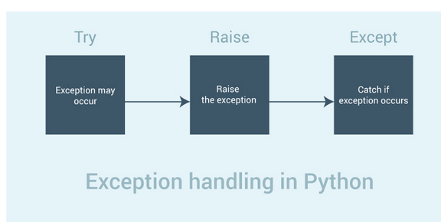

Slide 17
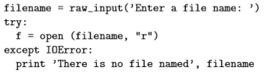
EXCEPTIONS
The error message has two parts: the type of error before the colon, and speciﬁcs about the error after the colon. Sometimes we want to execute an operation that could cause an exception, but we don’t want the program to stop. We can handle the exception using the try and except statements.
The try statement executes the statements in the ﬁrst block. If no exceptions occur, it ignores the except statement. If an exception of type IOError occurs, it executes the statements in the except branch and then continues.

Slide 18
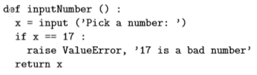
EXCEPTIONS
You can use multiple except blocks to handle diﬀerent kinds of exceptions.
If your program detects an error condition, you can make it raise an exception. Here is an example that gets input from the user and checks for the value 17.

Slide 19

EXCEPTIONS
The raise statement takes two arguments: the exception type and speciﬁc information about the error. ValueError is one of the exception types Python provides for a variety of occasions. Other examples include TypeError, KeyError, and my favorite, NotImplementedError.
If the function that called inputNumber handles the error, then the program can continue; otherwise, Python prints the error message and exits:

